Slide 1
Binary Literacy
Day 2: Optimizations and OOP
© Rolf Rolles, 2007

Slide 2
Introduction to Optimization
High-level optimizations effectively rewrite the source code. Are often concerned with loops or expression redundancy.
Medium-level optimizations reduce time / space consumption.
Low-level optimizations increase utilization of processor features, e.g. superscalar instruction sequencing.
Notes:
Optimization means many things: the majority of optimizations do not directly relate to substituting known-fast blocks of assembly language in for other statements.

Slide 3
High-Level Optimizations
These are “invisible” in the sense that you don’t know what the original code looked like: maybe all optimizations were applied, maybe none were?
They are more obvious in their absence than in their presence (e.g. unreachable code elimination).
Dead code elimination
Copy propagation
Inlining functions
Constant folding
Constant propagation
Unreachable code elimination
Notes:
Constant folding
Constant propagation
Unreachable code elimination

Slide 4


Dead Code Elimination
The creation of and assignment to variable A is dead because the value is not referenced afterwards.
By removing this variable, the compiler saves work for itself later on (e.g. allocating stack space, etc).
Many optimizations leave “dead” code behind, so dead code elimination is applied repeatedly throughout the optimization process.

Slide 5


Copy Propagation
Copy propagation substitutes uses of values directly in place of their copies, until the copy is re-assigned.
In this example, the variable j was entirely removed.
This optimization reduces the number of variables and can eliminate unnecessary code.

Slide 6




Inlining
C Declaration
Unoptimized ASM call
Optimized ASM code: contents of strcpy() have been literally inserted into the assembly.
C Call Site
Notes:
This is one of the more annoying optimizations.
Functions declared inline, or whose bodies are declared in header files, are automatically inserted literally into the calling function instead of incurring a function call via a call instruction.
The keyword “inline” is only a suggestion to the compiler: in reality, only functions within a module or those which are defined at their declaration are inlined.

Slide 7
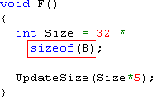

Constant Folding
#1
#2
#3
The compiler knows what sizeof(B) is, and inserts that constant. Not an optimization.
Size is being computed from arithmetic on constant values. The compiler computes the expression statically.
The final code shows the two constants “folded” into one.
Notes:
Original source:
int Size = sizeof(SomeStruct) * 32;
Post-semantic analysis:
int Size = 8 * 32;
There is no sense in computing this at runtime, since the arithmetic expression is constant. It should be done at compilation.
Hence:
int Size = 256;
Suppose you had code that looked like this:
int Size = sizeof(SomeStruct) * 32;
and the structure was 8 bytes. The compiler would detect this as an arithmetic operation with two constant values. It makes no sense to explicitly multiply at runtime, because we can compute this at compile-time.
The resulting code would then be:
int Size = 256;

Slide 8

Constant Propagation
Now that the variable ‘Size’ has a constant value, the compiler can insert it wherever the variable is used, until it is modified.
The variable ‘Size’ was eliminated entirely.
The compiler executes constant folding and propagation in tandem repeatedly, until the code no longer changes.
Notes:
(Example continued from last slide)
Suppose that the variable Size was only used once:
UpdateSize(Size * 5);
Size is a constant, so we can substitute it in:
UpdateSize(1280);
We have now “killed” the variable Size.
Propagation/folding are applied in tandem repeatedly.

Slide 9


Unreachable Code Elimination
The conditional will always fail, so the compiler can remove the if-statement and its body.
After constant propagation, the entire body of the while loop becomes unreachable.
Notes:
This would cause local variables within the dead conditional to be deleted.

Slide 10
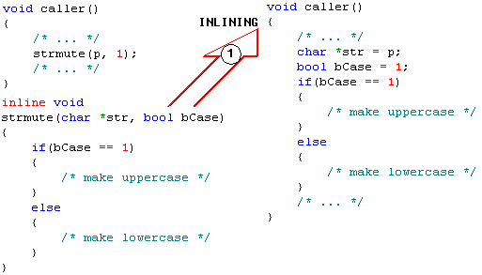
Combinations of High-Level Optimizations: #1

Slide 11
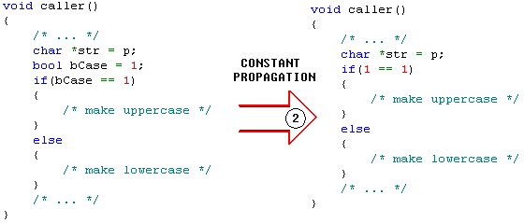
Combinations of High-Level Optimizations: #2

Slide 12
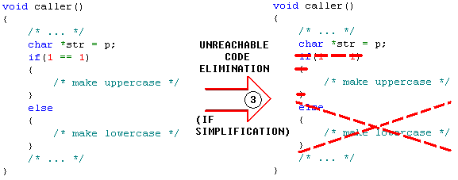
Combinations of High-Level Optimizations: #3

Slide 13
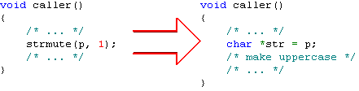
Combinations of High-Level Optimizations: Overall
We have inlined half of a function.

Slide 14
Loop Optimizations
Since programs spend most of their time executing in loops, it makes sense to target them for heavy optimizations – to move code out of them, to restructure them.
Code hoisting (loop invariant code motion)
Unswitching
Loop unrolling
Loop inversion
Induction variable simplification

Slide 15
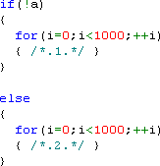
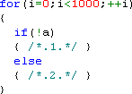
Unswitching
If the variable a is not changed within the loop, then the conditional will always evaluate the same way for each loop iteration.
By pulling the comparison out of the loop and creating two loops, 999 comparisons are saved, among other gains.

Slide 16
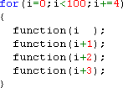
Loop Unrolling
The body of the loop is very short. Very short loops are detrimental to performance on modern processors (this will be discussed in depth later).
This version accomplishes four times as much work per loop check/update.

Slide 17
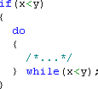


Loop Inversion
while loops involve multiple branches, whereas do-while loops involve a single branch. The latter is better for the processor (discussed later).
If the compiler can determine that a while loop will be entered, then it can be converted into a do-while loop without issue.
Otherwise, the compiler can convert it anyway, and insert an explicit if-statement beforehand to check whether the loop will be entered.
Notes:
See: CD:IDBs\Example—Interesting-Control-Flow—WhileDo.idb

Slide 18
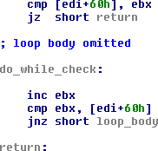
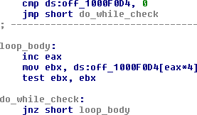
Loop Inversion
GCC has inverted this while loop by re-using the comparison in the loop-check portion.
MSVC has inverted this while loop by inserting an if statement beforehand.

Slide 19

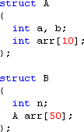

Loop-Invariant Code Motion
The beginning of b.arr[i].arr is recomputed continually, but i is not changing throughout the loop.
A semi-complex structure.
The address of the array is computed once, saving nine such computations.

Slide 20

Induction Variable Optimizations
Addition is cheaper than multiplication, so the compiler can convert this fragment to the one on the right.
A temporary variable has been introduced in order to eliminate the multiplications.

Slide 21

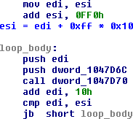

Induction Variable Elimination
#1: Here is a simple loop operating upon pointers.
#3: The generated code might look like this.
#2: To reduce complexity, the compiler uses a pointer as the induction variable instead.

Slide 22
Control-Flow Optimizations
These optimizations improve the control-flow structure for a function in various ways.
High-level
Branch-to-branch elimination
Switch via binary search
Tail merging
Low-level
Compound conditionals
Tertiary operator
Conditional moves

Slide 23
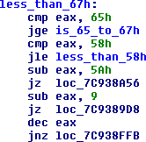
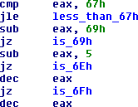

switch via Binary Search
Suppose a switch’s cases are not in a small sequential range; O(1) case lookup is ruled out. MSVC may build a binary search algorithm, partially illustrated above, to find the case statement. This operation takes O(log(N)) time to find the correct case.

Slide 24
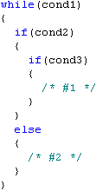
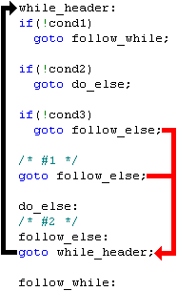
Branch-To-Branch Elimination
The red arrows can instead point at the black target, instead of a branch that takes them there.
Notes:
In the course of generating code for a function, the intermediate language or the assembly language may be moved around or deleted. You might end up with a scenario where there’s a jump to a jump.
In this case, a jump should be made to the destination, and if possible the other jump deleted.
This is one of those optimizations that you don’t notice unless it’s not applied, in which case you’ll see nodes consisting of one unconditional jump instruction in the graph.

Slide 25
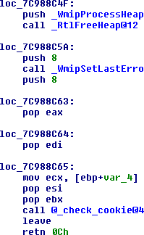
Tail Merging
This 2600-byte function has a single exit path.
There are 14 references to the named locations.

Slide 26
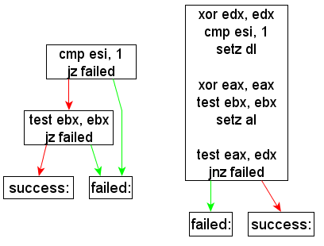
Compound Conditionals
Less branches = more straight-line code = better processor performance.

Slide 27


sbb Instruction
The sbb instruction subtracts the two operands, like sub would, and then subtracts the carry flag (0 or 1). This is used for evaluating conditionals without branches.
If [ecx+784h] >= 2, eax == 1. Otherwise, eax == 0.
eax = (ecx.f784 >= 2);
EDI=0 | EDI!=0
0 | -1
0 | FFFFFFC7h
47h | 0Eh
edi = edi ? 0xE : 0x47;

Slide 28

Conditional Moves
Conditional moves (also called predicated moves) are used heavily on ARM. Almost every ARM instruction allows predication. This is another technique for eliminating branches.
If eax == 0, then ecx remains the same. Otherwise, move esi into ecx.

Slide 29
Redundancy Elimination
These optimizations (and others) are responsible for reducing the number of expressions and sub-expressions in use.
Instead of computing “len+1” repeatedly, why not do it once and save the result?
Common sub-expression elimination
Partial redundancy elimination

Slide 30
Common Sub-Expression Elimination
int e = b + c + d;
int f = a + c + d;
Struct2->Struct1->Member1
Struct2->Struct1->Member2
The values need only be computed once.

Slide 31

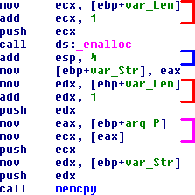
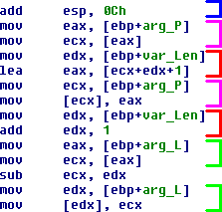
C Compiled With Redundancy
Notes:
MSVC 98

Slide 32
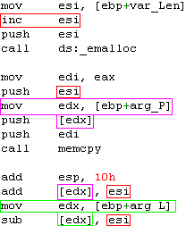
C Compiled Without Redundancy

Slide 33
Efficiency Optimizations
These operations are concerned with generating faster, machine-specific code from high-level constructs.
Machine idioms
Strength reduction (weak/general)
Zero register

Slide 34
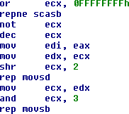
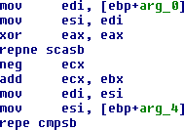
Machine Idioms
For certain operations, handcrafted pieces of assembly outperform what the optimizer could ever aspire to produce.
Both of these examples are faster than their natural loop-based equivalents.
strcpy
strcmp

Slide 35
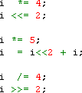
Strength Reduction: Multiplication
Add and multiply/divide by powers of 2 are cheap. Real multiplication and division are not.
Instructions such as lea, shl, and shr are commonly used to simplify multiplications/divisions.
eax = eax*12 + ecx

Slide 36
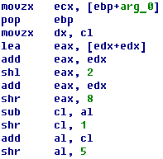
Strength Reduction: Division
Algorithms for fast division are very nasty things to look at, but they can be faster than the CPU’s divide instruction, and some CPUs don’t have one.
Divide a character by 61.
See the book “Hacker’s Delight” to see how these algorithms work.

Slide 37
Zero Register
The value zero is frequently used, so it can make sense (for size and CPU reasons) to assign a dedicated register to hold it.
No graphics required: a register is simply zeroed in the function’s prologue, and then not changed throughout the function.

Slide 38
Stack-Frame Optimizations
Modern compilers use the stack more efficiently than older compilers: they try to consume less stack space, and reduce the number of times the stack needs to be accessed.
Fastcall calling convention
ESP-based frames
Frame-pointer deltas
Stack space sharing
Tail-call optimizations
Re-using dead stack space
GCC’s latest abomination
Register saving
Register allocation

Slide 39

Tail Call Optimizations
Suppose that a function ends with
“return func1();”.
If possible, the compiler may destroy the stack frame before invoking func1, by jumping to (instead of calling) that function.
Notes:
This is a big win for self-recursive functions that have large stack variables. Those variables will not consume the stack during recursion.
Suppose that the last thing a function does is call another function without using anything on its own stack frame, and the called function takes less or the same number of arguments as the caller. This is called a “tail call”.
Since the function is about to return, the epilogue can take place before the function call. In other words, remove everything on the stack up to the return address, and then jump to the called function. The return address of the caller is in place as though the caller had made a direct call to the tail-called function.

Slide 40

Fastcall Calling Convention
Using registers for function arguments requires less stack accesses.
Compiler | Registers Used In Order
MSVC | eax, edx
Watcom | edx, eax, ebx, ecx
Borland BCC | eax, edx, ecx
GCC | “Arbitrary”

Slide 41
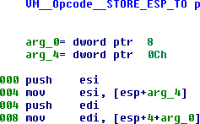
ESP-Based Frames
Instead of using EBP as a frame pointer, the compiler may simply use displacements off of ESP to access local variables and arguments.
This frees up EBP to be used as a general register.

Slide 42
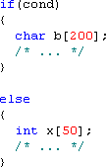
Stack Space Sharing
These two variables have live ranges that do not intersect.
Therefore, the compiler can assign them to the same portion of the stack, since both cannot exist simultaneously.

Slide 43
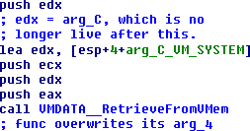
Re-Using Dead Stack Space
Once a stack item is no longer live (or is live in a register), its stack slot can be re-used for any other purpose.
In this example, arg_C has been held in EDX for the entire function. The last time arg_C is used within the function is for this call. Thus, the compiler immediately reassigns both the register EDX and arg_C’s stack slot.

Slide 44


Frame Pointer Deltas
This is a typical stack frame. The red box shows the portion of the stack that can be accessed through [ebp-80h]…[ebp+7Fh], which fits into two bytes. Accesses outside of the box cost five bytes apiece.
Being able to access stack memory above the topmost argument is unnecessary, so by moving EBP downwards, we increase the number of variables that can be accessed with two bytes.

Slide 45
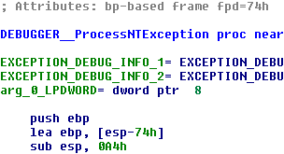


Frame Pointer Deltas
#1: Notice “fpd=74h”
#2: Notice how the size of the local variables is 0A4h, and ebp is displaced +30h into the bottom of it.
The same code with the stack variable names. arg_0 @ +7Ch is at the last 2-byte displacement. Variables are usually EBP-X.
Raw stack accesses.

Slide 46

GCC’s Stack Frame Handling
The instruction mov [esp+X], imm32/reg32 can be faster than push on P4.
GCC function prologues subtract 4*num arguments (for the call with the most) extra bytes from ESP, then use mov, not push.
Thus, cdecl functions do not need to clear the arguments after a function call.

Slide 47
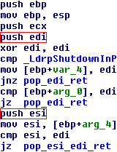
Register Saving
A function and its callers must agree upon which registers must remain intact after the call, and which can be “clobbered”. E.g. clobbering EBP = bad (crash).
Safe and slow answer: save everything in the prologue.
Better: save less registers, and only save when needed.
This function avoids saving the register ESI until it is actually used. If the function exits early, ESI does not need to be restored, since it was not modified.
Notes:
If a function clobbered EBP, callers would crash the next time they accessed stack variables.

Slide 48
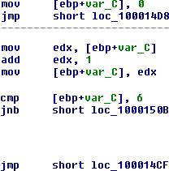
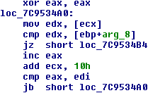
Register Allocation
Reduces the number of stack accesses by assigning variables into registers.
One of the most important optimizations.
Can make the code much harder to follow.
loop body omitted
In this example, the loop’s index has been allocated to EAX, not a stack variable.
Notice the gratuitous use of stack variables.

Slide 49
Implications of Register Allocation (RA)
Without RA: each local variable gets its own stack slot. Easy to determine the set of variables used in a function.
With RA: local variables might not get stack slots at all.
With RA, the reverse engineer must pay closer attention to the contents of the registers than without it.

Slide 50
Optimizations for Modern CPUs
Modern CPUs are heavily nuanced creatures. Advances in CPUs are not solely measured in raw MHz.
For best performance, compilers must generate code such that the processor’s quirks are best accounted for.
Overall OS performance (global memory paging) can also benefit from careful choices about code placement.
Processor Features
Pipelined execution
Instruction cache
Branch prediction
Vectorized instruction sets
Optimizations
Instruction scheduling
Branch/function alignment
Profile-based code placement
Vectorization

Slide 51
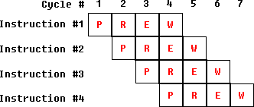
Pipelined Execution
Pipeline stages execute concurrently: [W1, E2, R3, P4]
P = Prefetch, R = Read, E = Execute, W = Write
Note: this gross simplification does not depict a real processor.
Four pipelined instructions execute in seven cycles versus sixteen non-pipelined cycles. As instructions finish executing, more must be inserted into the pipeline. Best performance occurs when the pipeline is full at all times.
Notes:
Modern processors often have multi-instruction pipelines in which parts of sequential instructions are executed simultaneously.
If a register is written into and then read from by the next instruction in the pipeline, a stall will occur waiting for the previous instruction to write its value to back to the register.

Slide 52
Dependency-Induced Pipeline Stalls
Since parts of instructions execute concurrently, if instruction #2 uses the results of instruction #1, the pipeline will stall during #2 waiting for #1 to finish.
Bad Better
mov eax, [ebp+4] mov eax, [ebp+4]
mov [ebx+4], eax mov edx, [ebp+8]
mov edx, [ebp+8] mov [ebx+4], eax
mov [ebx+8], edx mov [ebx+8], edx
Notes:
THIS is why you see computations being inter-mixed with one another.

Slide 53

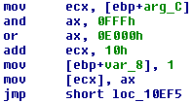
Instruction Scheduling
Two instructions that do not change the flags are inserted between the cmp (w/memory reference) and the jmp.
Notice how the computations of ax and ecx are interleaved.

Slide 54
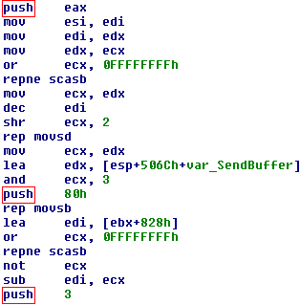
More Instruction Scheduling
Two strcpy()s and some other string manipulations have been inlined and scheduled in between the pushes for a call to CreateFileA.

Slide 55
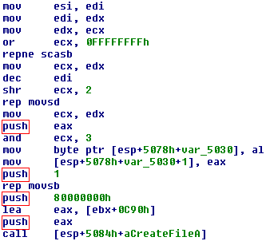
More Instruction Scheduling
This example illustrates that instruction scheduling makes it harder to determine the natural statement boundaries in compiled code.

Slide 56
Instruction Cache
When the CPU inserts instructions into the pipeline, it first makes a request to its “instruction cache” (I-cache) to read their raw bytes.
The reads are of fixed length (i.e. 16 bytes). One read usually fetches multiple instructions.
The reads occur at boundary-aligned addresses (i.e. 16 bytes).

Slide 57
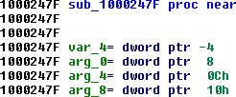
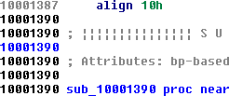
Instruction Cache: Alignment
The CPU issues a 16-byte I-read at 0x10002470. Only the last byte, at 0x1000247F, is useful. It must issue another read at 0x10002480 to read the rest of the first instruction.
This is why functions and branch targets are often aligned at 16-byte boundaries: all 16 bytes of an I-read are useful (potentially).

Slide 58
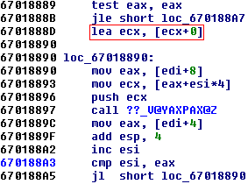
Instruction Cache: Alignment
Similarly to the last slide, the compiler will often align loops to 16-byte boundaries.
In this case, a three-byte nop,
lea ecx, [ecx+0], has been inserted.
Sometimes you will see multiple lea instructions, or seven-byte leas.

Slide 59
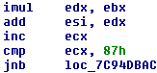
Branch-Induced Pipeline Stalls
Should we load the instructions that follow this, or those at the branch target, into the pipeline? Which side of the branch will execute?
The processor makes an educated guess. If it makes a mistake, it must flush the wrong instructions from the pipeline and load the correct ones, thus wasting cycles.
Pentium 4 branch prediction algorithm:
Backwards branch => predicted taken.
Forwards branch => predicted not taken.
The processor also has a “branch prediction table” that records the history of recently-executed branches.

Slide 60
Profiling Optimizations
Through profiling (run-time statistics gathering) the compiler knows which code is executed the most often.
With this, it arranges basic blocks such that the most likely outcome of a conditional follows that conditional, and the other branch is forward.
=> Maximize branch prediction success when profiling data matches real-life execution patterns.
MSVC also uses this data for arranging functions in an OS-friendly way.
Notes:
The profiling data is used to compute the “live path” throughout a control flow graph, i.e. that path which is most commonly accessed.
The conditionals for those branches are then structured in such a way where the blocks on the live path fall through to one another. The non-live blocks are placed elsewhere.

Slide 61
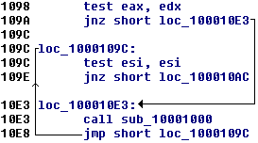
GCC’s Profiling Optimization
The first jump is not likely to be taken, so the jump is in the forwards direction.
The side of the branch that is likely to execute is placed immediately after the branch.
All of the function’s code fits in a single region.
Notes:
The difference between GCC’s profile-based optimizations and MSVC’s is that all parts of a GCC function fit within one contiguous region, whereas MSVC tends to spread code throughout the binary.
Indeed, portions of the first function in a binary may end up at the end of the code.

Slide 62
MSVC’s Profiling Optimizations
Split functions into sets of “hot” and “cold” basic blocks. Causes “function chunking”.
Sort the functions and cold blocks by frequency of execution. Thus, memory pages consist of portions of code with roughly the same likelihood of being executed.
If the OS needs to trim the process’ memory, the least-likely-to-execute code will be paged out first. Reduces “page thrashing” (repeatedly swapping the same memory in and out).

Slide 63

Hot and Cold Parts of Functions
Suppose that profiling data indicates that the magenta path through the function is the one that’s most commonly taken. This is the “hot” part.
The main body of the function will consist of the magenta path, laid out in sequence. The white blocks (cold part) will be placed elsewhere.

Slide 64
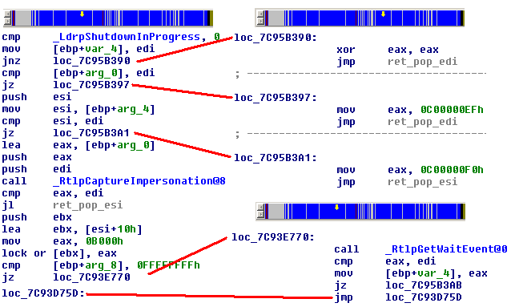
MSVC: Hot/Cold + OS Paging
This side is the cold parts. They are on different memory pages.
This side is the hot part.
Notes:
Extends the basic block profiling optimizations. We can divide a function into a “hot part”, the live path, and a “cold part”, everything else.
Cluster together the “hot parts” of functions into the least number of memory pages possible, and put the cold part elsewhere in the binary.
If the OS runs out of memory and has to trim inactive pages, the “cold” pages will be the OS’ first candidates. Paging out cold instead of hot pages leads to less cache thrashing.

Slide 65
Vectorization
The next big step in compilers (Intel, GCC 4) is to automatically adapt code to make use of the processor’s fast vector math instructions (SSE/MMX/3DNow!).
The term Single Instruction, Multiple Data (SIMD) describes instructions that perform the same operation upon multiple values simultaneously.

Slide 66
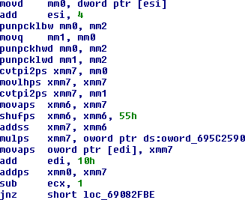
Vectorization

Slide 67
References
Advanced Compiler Design and Implementation by Muchnick.
Optimizing Compilers for Modern Architectures by Allen and Kennedy.
Hacker’s Delight by Warren.
A binary near you.

